Slide 1

Lab 1: Introduction to R & RStudio
ENS 495
Design & Analysis

Slide 2

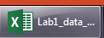
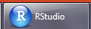

Outline of Today’s Lab
What is R
Save data from Excel into proper format
Open R via RStudio
Get to know R a little bit
Open data in R
Learn basic R commands &
investigate data on bald eagles

Slide 3
What is R
It does math
It does stats
It makes figures
You can write computer programs to automate these things

Slide 4
Why use R
Its free – for students, government, business, anyone
Its free
Its used by statisticians to develop new statistical techniques
Its used by all ecological statisticians develop new techniques (mark recapture, distance sampling)
It allows stats, graphics, and modeling, all for free

Slide 5








A very well-funded scientist might use all of these
RAMAS ecolab

Slide 6
A not very well funded scientist will just use these

Slide 7
A poorly funded scientist might just use Excel
Excel
-very good for data entry
-very good for basic data management
-good for making tables
-cannot make many basic scientific figures
-cannot do most modern statistics

Slide 8



Who uses R
http://blog.revolutionanalytics.com/2014/05/companies-using-r-in-2014.html

Slide 9
Part II: Getting started w/R
What we’ll do
Get some data ready in Excel
Set up RStudio
Load data into Rstudio
Examine it
Plot It
Add more data to Excel
Examine it, plot it etc.

Slide 10
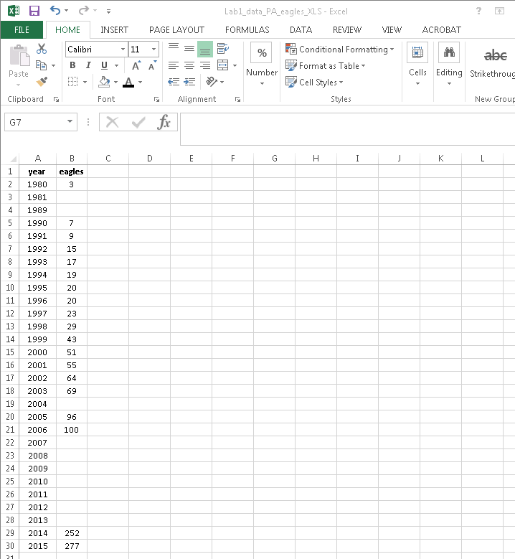
Open data in Excel
Excel files are in “xls” or
“xlsx” format
This format CANNOT be
Read by stats programs
(neither R, SAS, etc)
Download this file
1_Lab1_data_PA_eagles.xlsx
And save it to your computers
desktop

Slide 11
Save the Excel data to “working directory”
“working directory” is an R term for where your data files live
“WD” for short
We will set the working directory in R to your desktop today for convenience

Slide 12
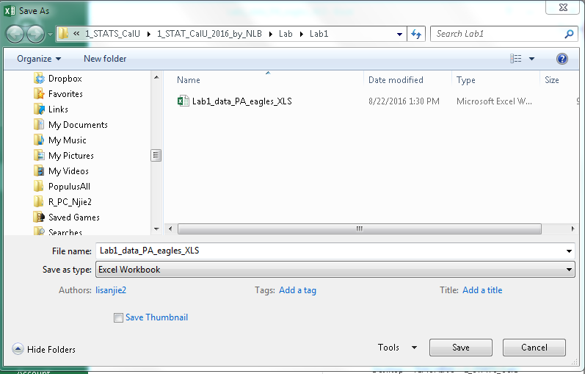
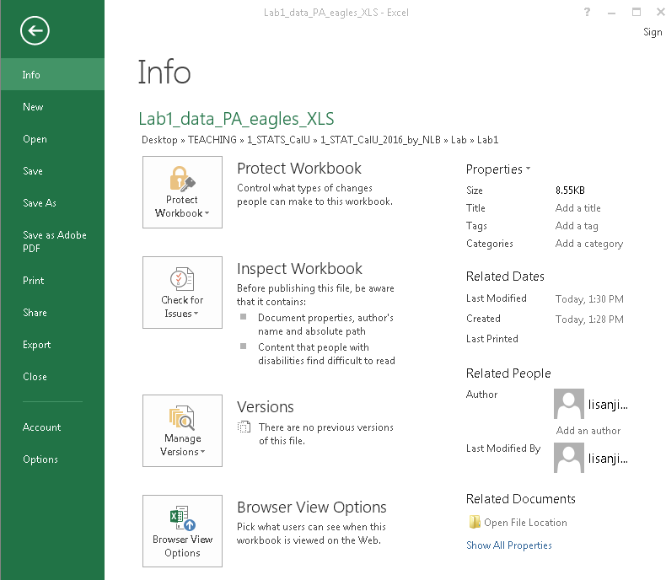
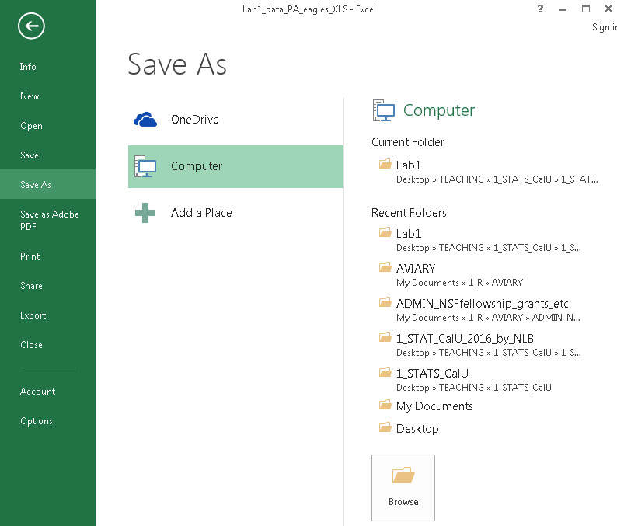
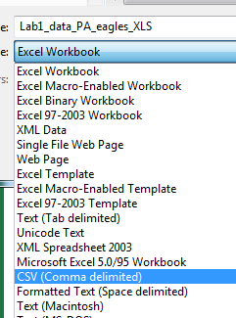
Save data as a “csv” file on the desktop
1)
4)
2)
1)”File”
2)”Save As”
3)”Browse”
4)Select WD
5)”Save as type”
6)Select
“CSV (Comma delimited)”
7)Click “Save”
5)
3)
6)

Slide 13
IIb)Getting to Know RStudio

Slide 14
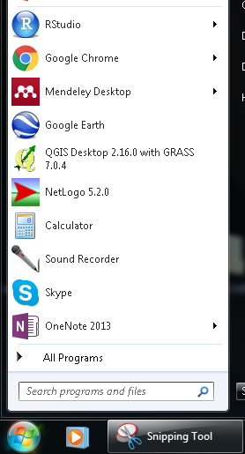
Open R Studio

Slide 15
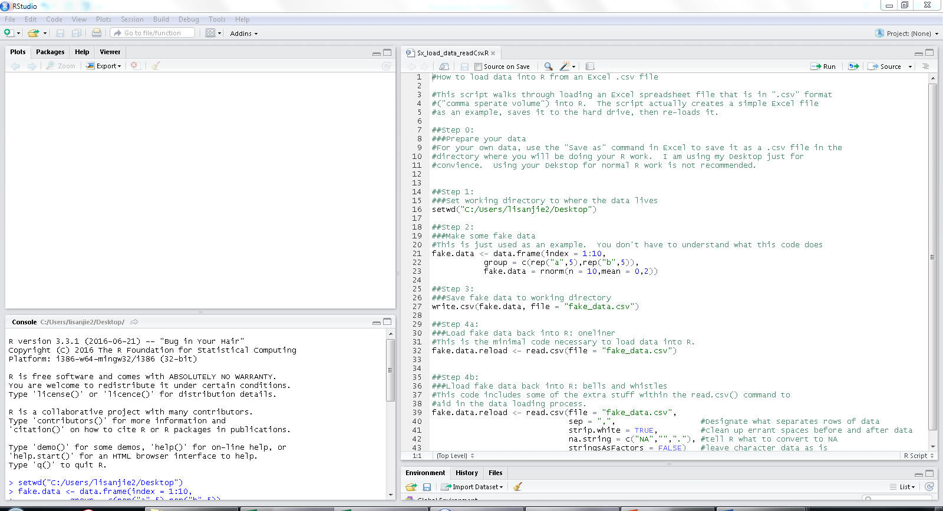

Slide 16
“SOURCE VIEWER”
or
“SCRIPT EDITOR”
“CONSOL”

Slide 17
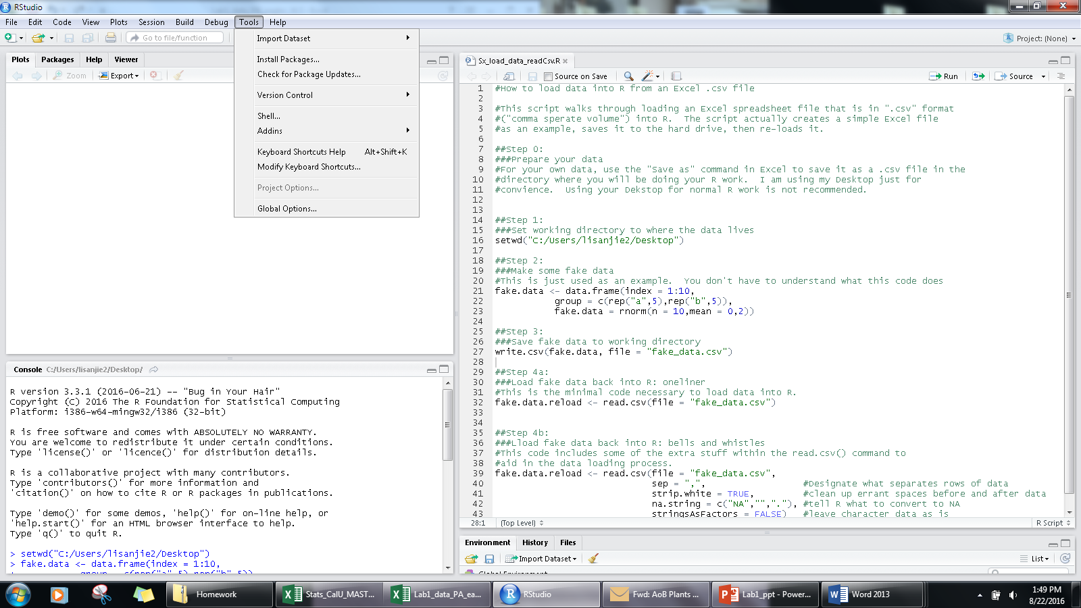
Setting up RStudio to all look the same
1)”Tools”
2)”Global options”

Slide 18
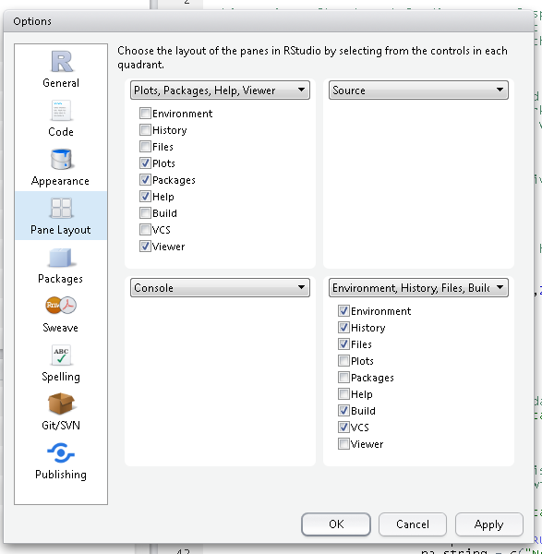
Setting up RStudio to all look the same
1)”Tools”
2)”Global options”
3)Pane Layout

Slide 19
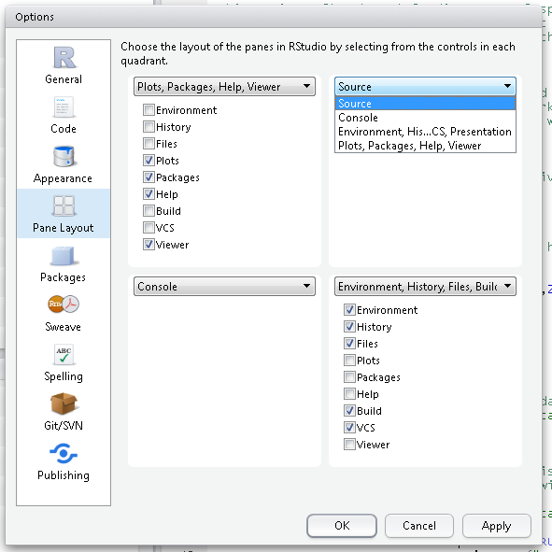
PLOTS
Upper left
“SOURCE “
In upper right
CONSOL
In lower left

Slide 20
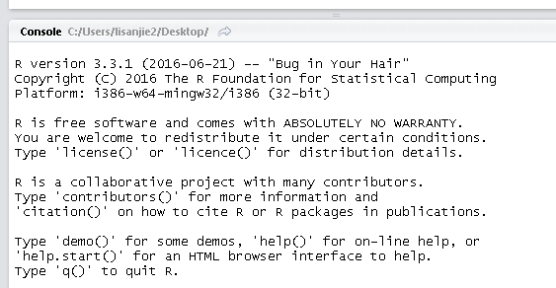
The version of R you are using

Slide 21
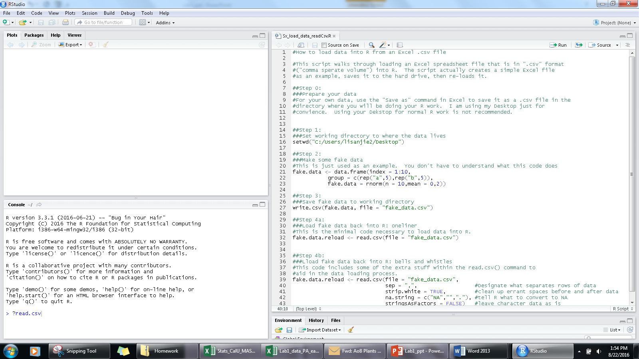
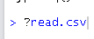
Getting “help”
Type “?read.csv”
Note: the “>” is always there
Don’t type it

Slide 22
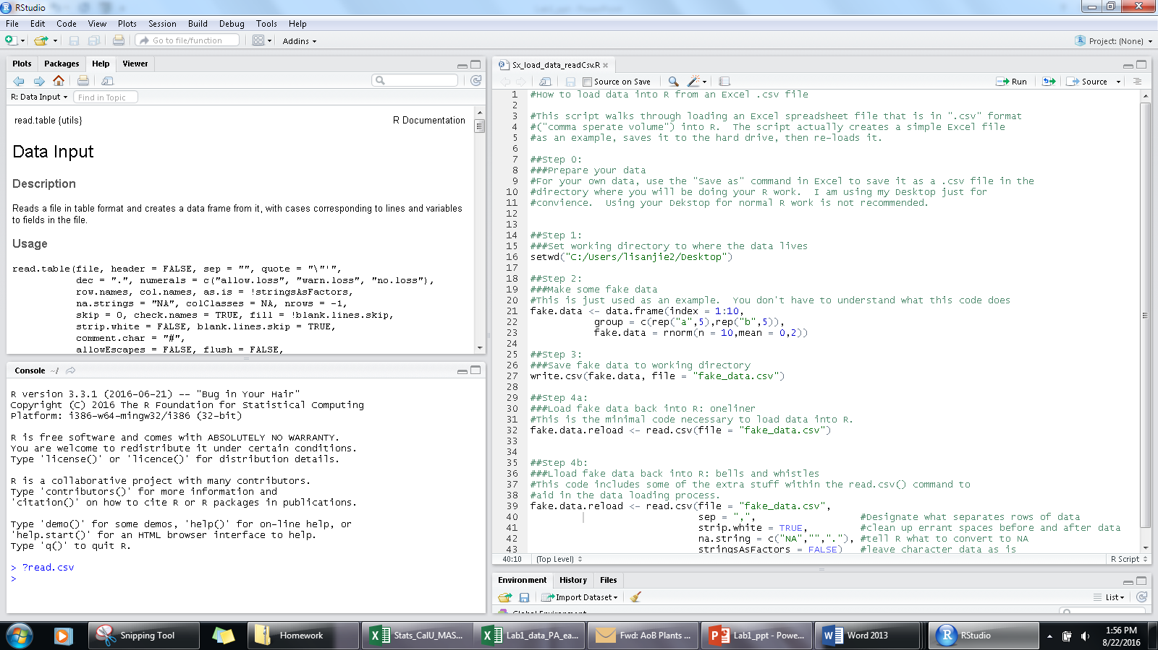
More on this later
Note that b/c R is so helpful, you asked for “read.csv” but you got “read.table” …
&$#@& computer programmers…

Slide 23
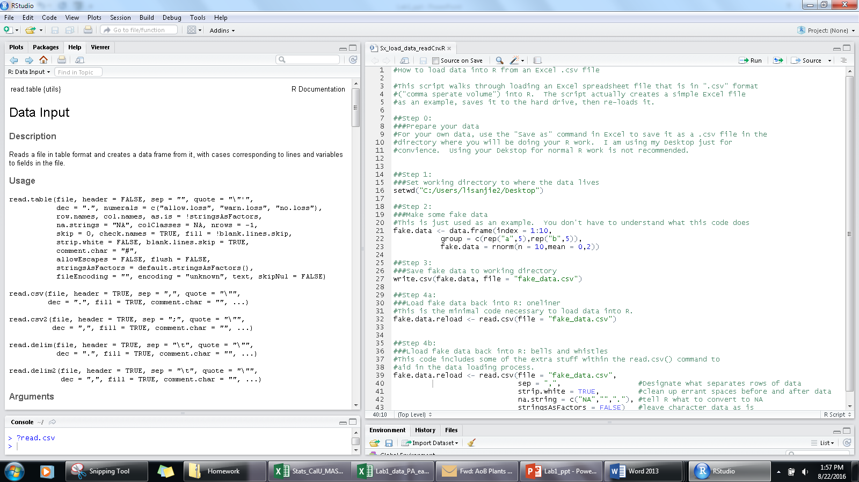
You can adjust the size of windows

Slide 24
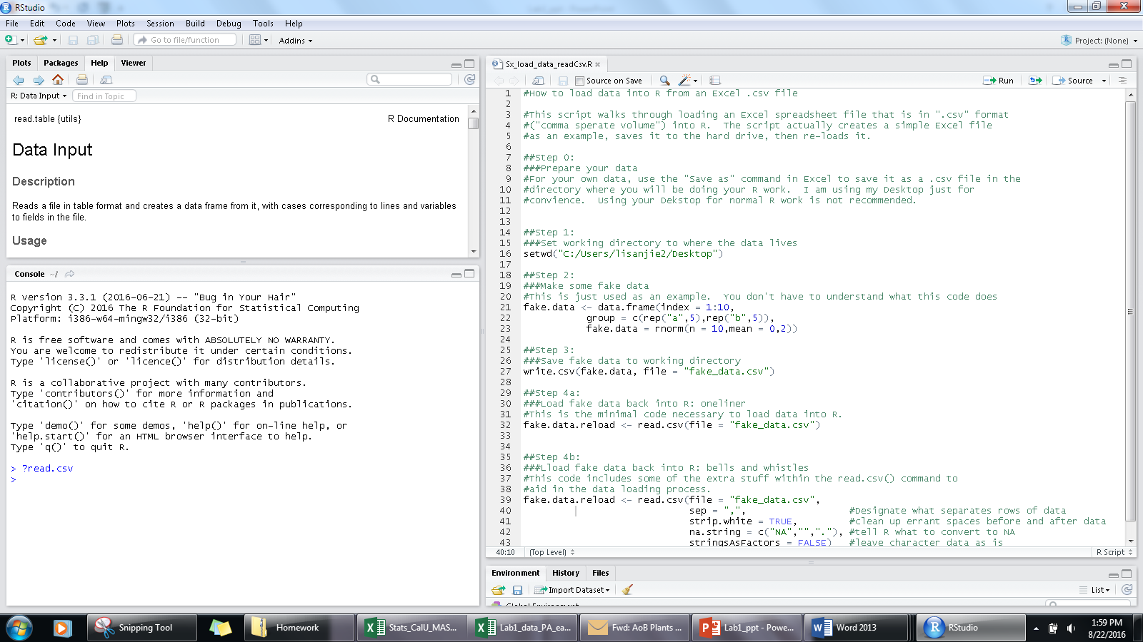
We mostly want to see
The “Consol”

Slide 25
IIc) Loading Data into RStudio

Slide 26
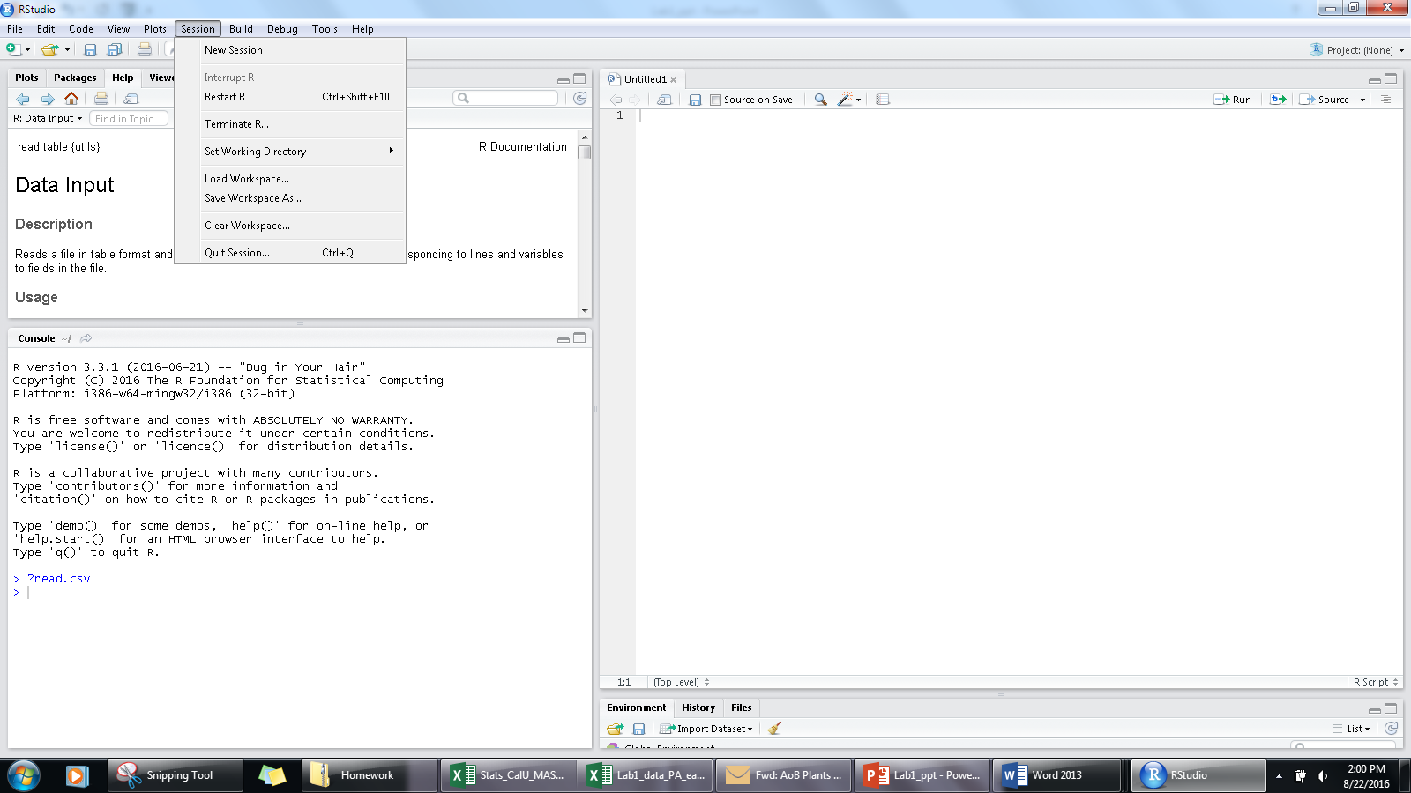
Set the “working directory”
(“WD”)
“Session”
“Set working directory”

Slide 27
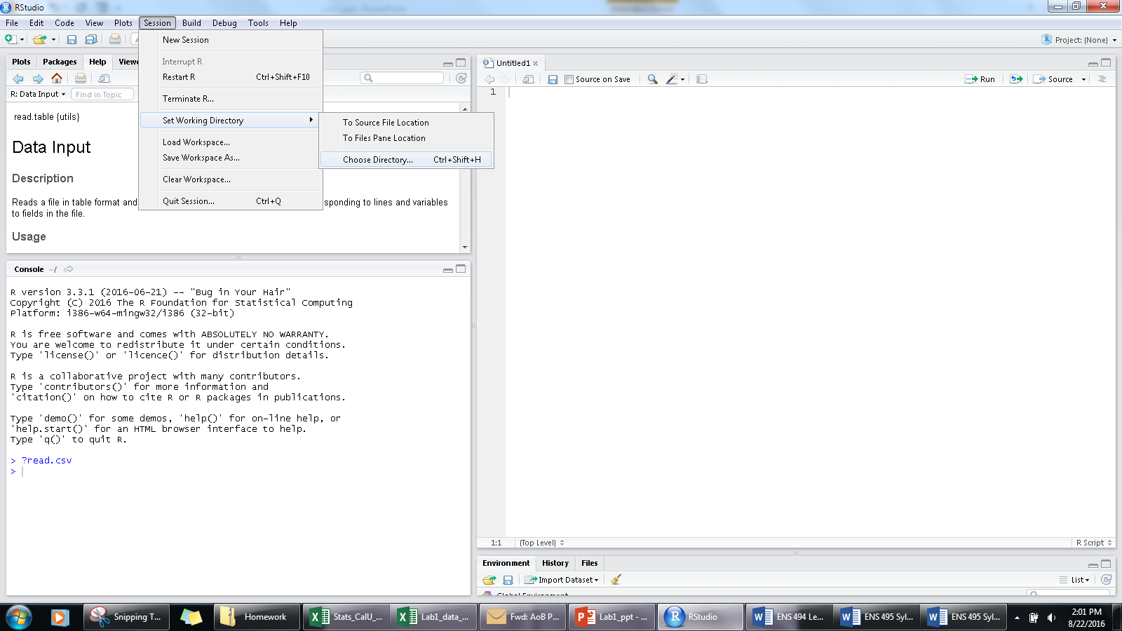
Set the “working directory”
“Session”
“Set working directory”
“Choose Directory”

Slide 28
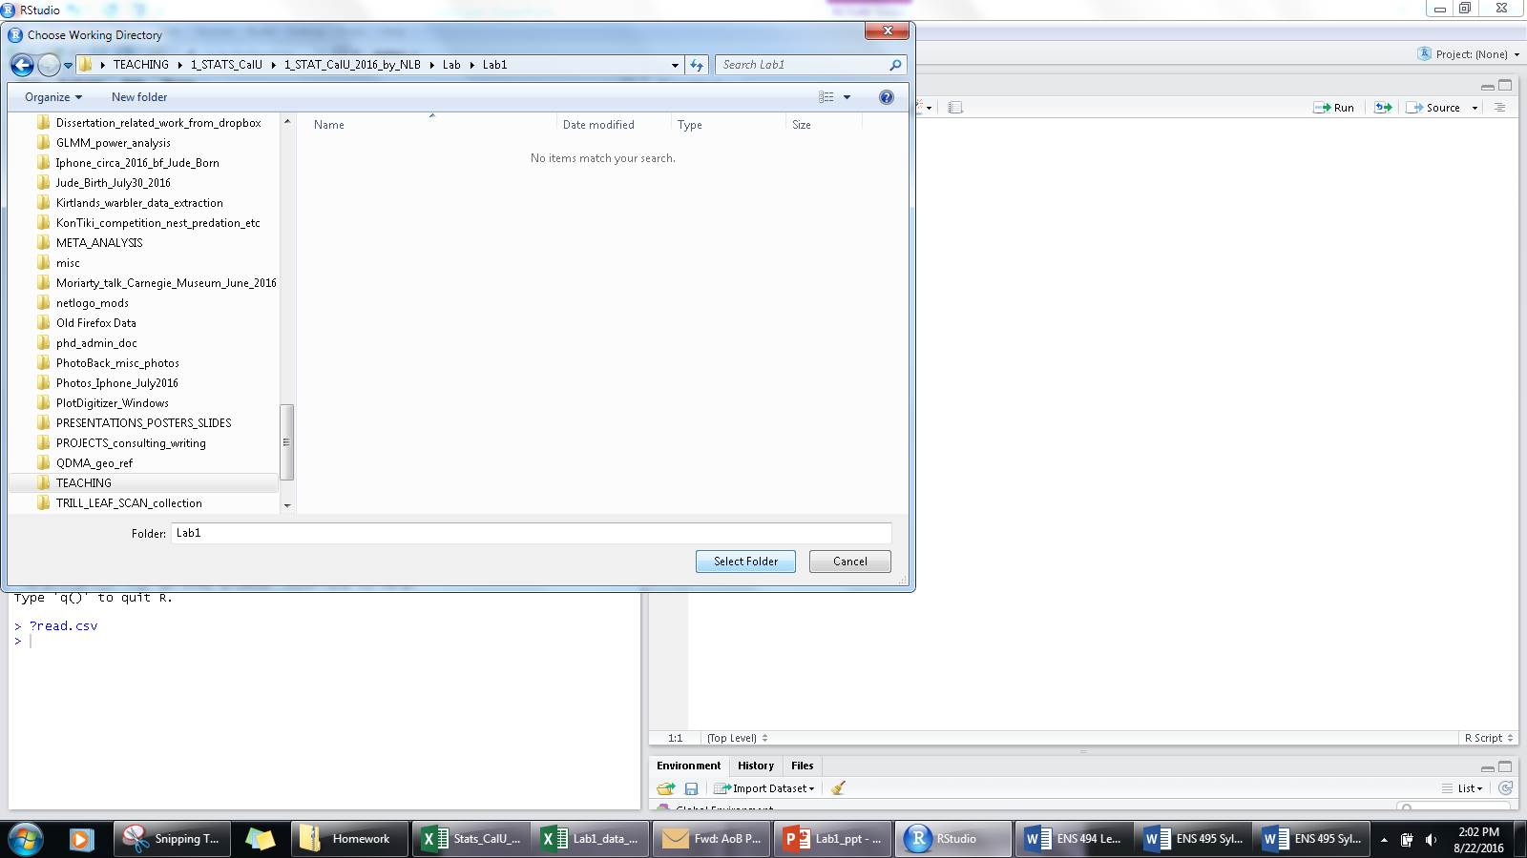
Set the “working directory”
“Session”
“Set working directory”
“Choose Directory”
Select directory & click
“Select folder”

Slide 29
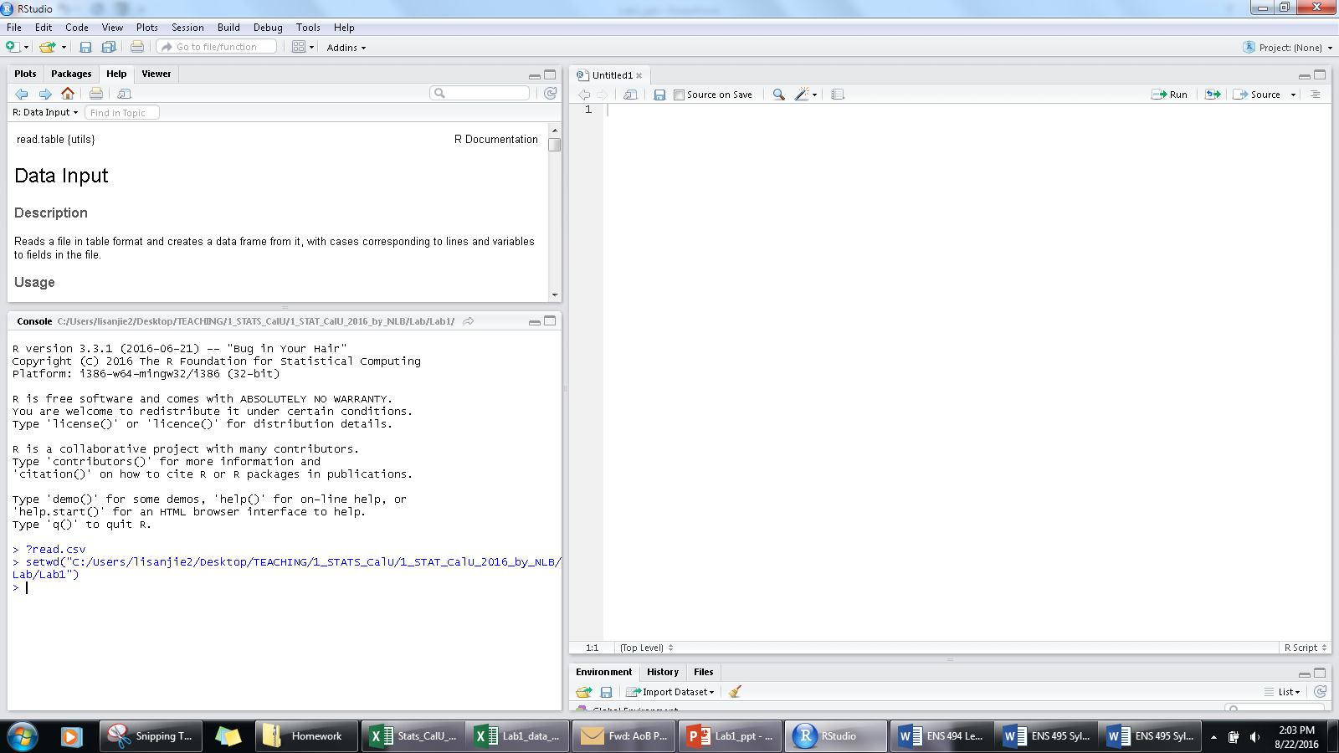
The command “setwd” shows up followed by the location of the directory you selected

Slide 30
IId) Interacting with R Executing commands in the CONSOL

Slide 31

Type
“getwd()”
Must have both ( and )
Press enter

Slide 32
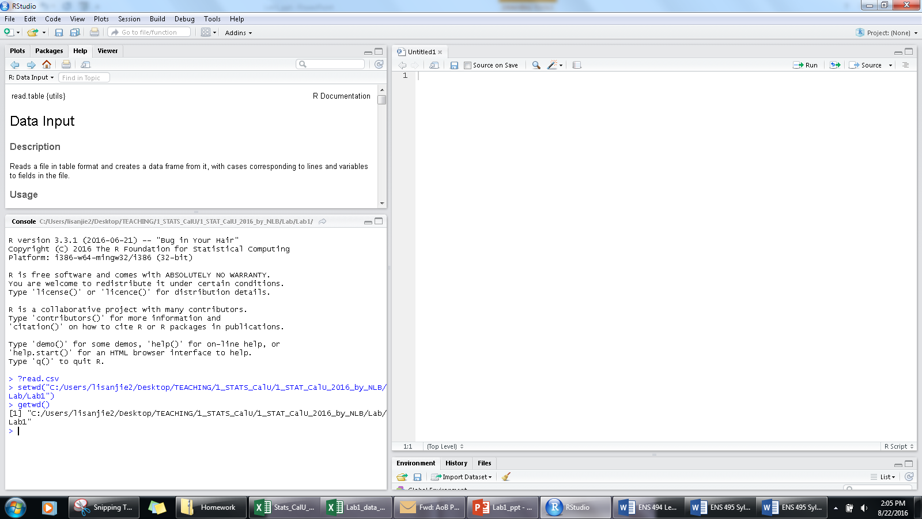
Prints out your working directory

Slide 33
IIe) Interacting with R Executing commands from the SOURCE VIEWER part 1

Slide 34
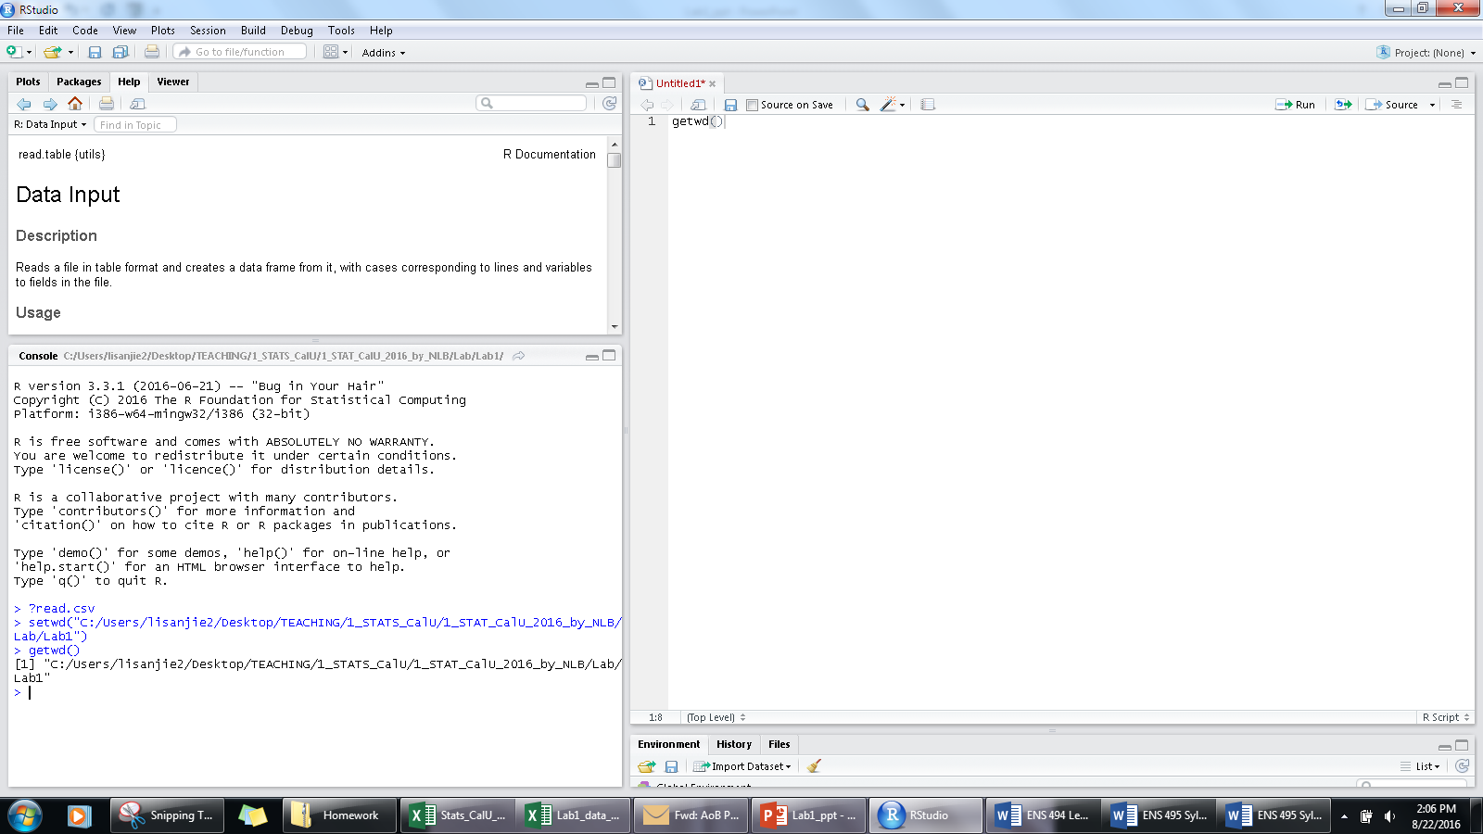
Click on the source viewer
Type
“getwd()” in the
source viewer

Slide 35

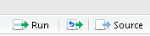
Click on “Run”

Slide 36
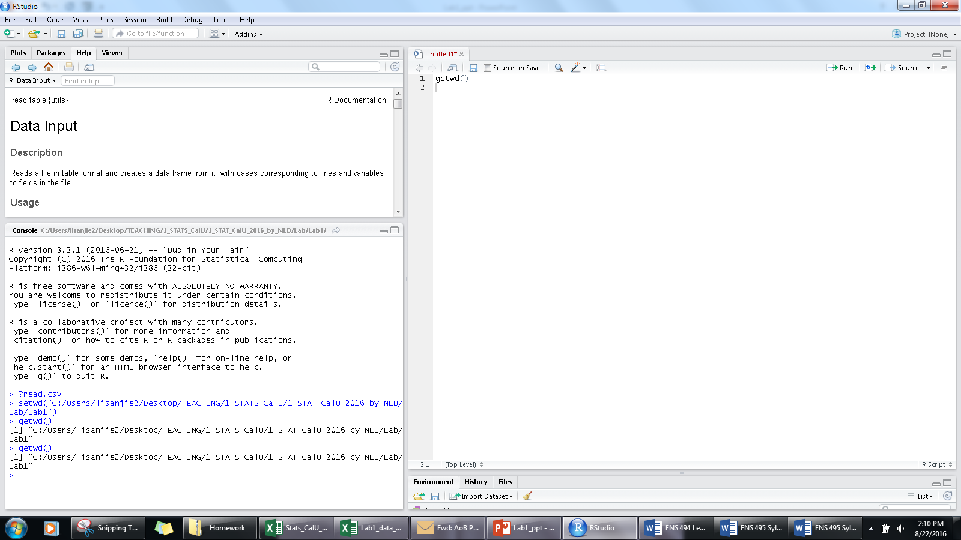
The getwd() command is
sent over to the consol
and excucted

Slide 37
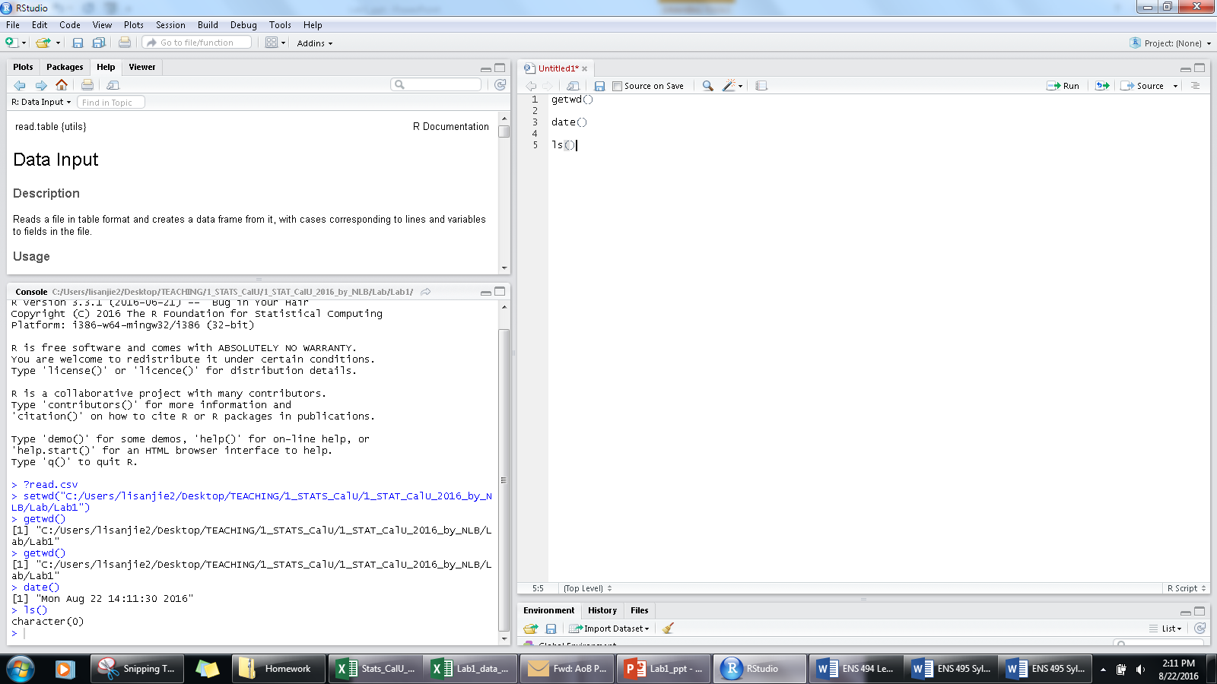
Try these commands in the source view
date()
ls() “l” = lower case “L”
“ls” means “list”.
More on this later
?

Slide 38
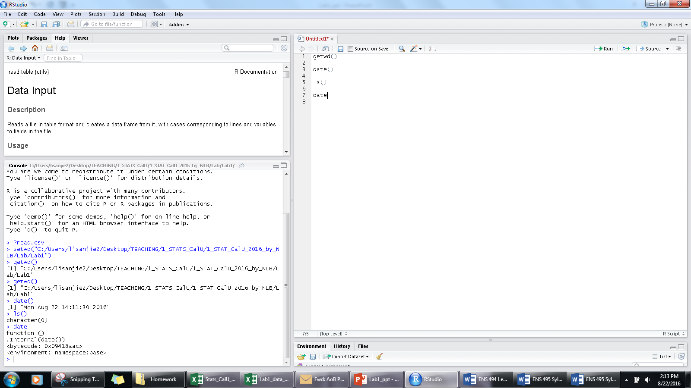
Now try just “date” without the parentheses.
What happens?
NB: parentheses are key to the execution of commands in R!
?

Slide 39
NB: parentheses are key to the execution of commands in R!
When things don’t, one of the 1st things to check for are parentheses

Slide 40
IIf) Interacting with R Executing commands from the SOURCE VIEWER part 2

Slide 41
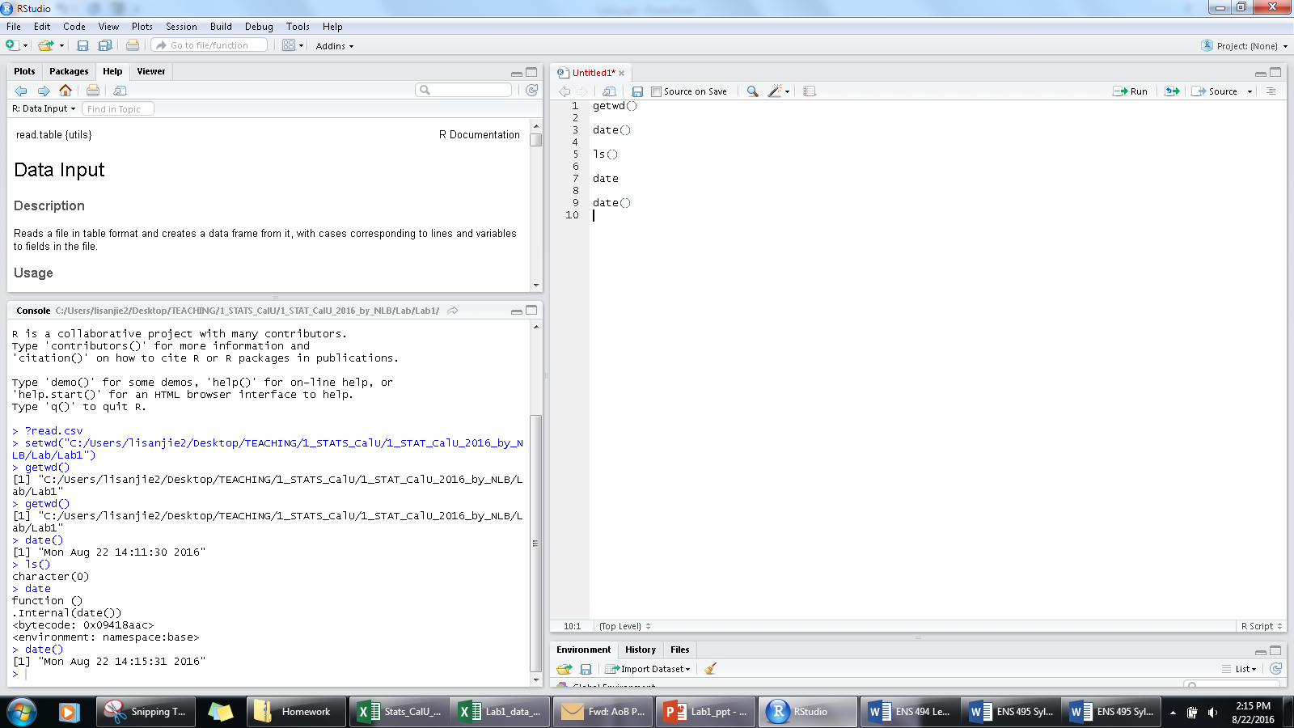

Type date & instead of clicking “Run”
put the curser right after the last parenthesis and press “Crlt+Enter”

Slide 42
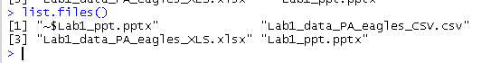
Execute the command “list.files()”
This tells you what files are saved in your working directory (wd).
There should be the original xlsx &
the csv file you made.
We will load the .csv file into R

Slide 43
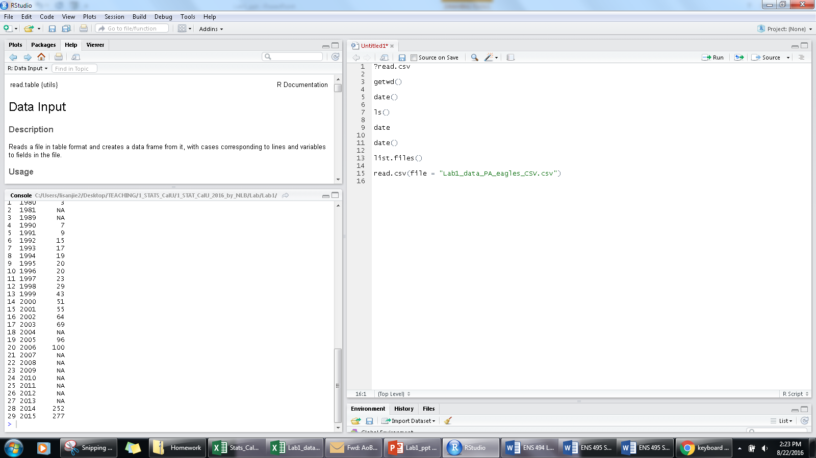
Copy and paste the CSV file name from the consol in the source view
Execute the command
read.csv(file = "Lab1_data_PA_eagles.csv")
You must have the file name in quotation marks and include “.csv”

Slide 44
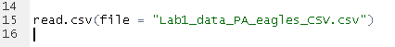
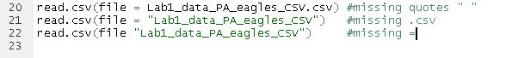
Correct:
InCorrect:

Slide 45
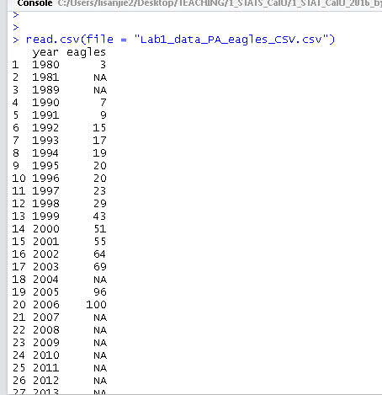
What happens when you execute the command
read.csv(file = "Lab1_data_PA_eagles.csv")
Does this look the same as your excel data?
How is it different?
What do the NAs mean?

Slide 46
The blanks in the Excel file have been changed to “NA”.
“NA” means “does not apply” or “missing data”.
“NA” are very important and they will be discussed later.

Slide 47
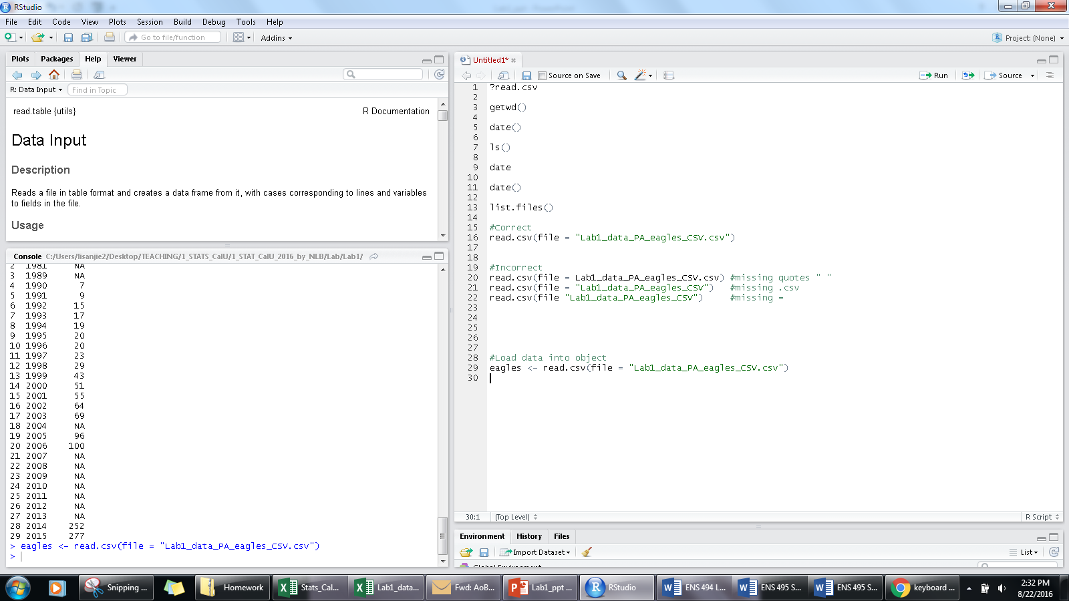
Now type this:
eagles <- read.csv(file = "Lab1_data_PA_eagles.csv")
What happens when you execute this command?

Slide 48
“<-” is called the “assignment operator”.
It is a special type of R command
“<“ is usually
Shares The
comma ( , ) Key
Type “shift + , “
To get it
You have “assigned” the data from your file to the “object” named “eagles”

Slide 49
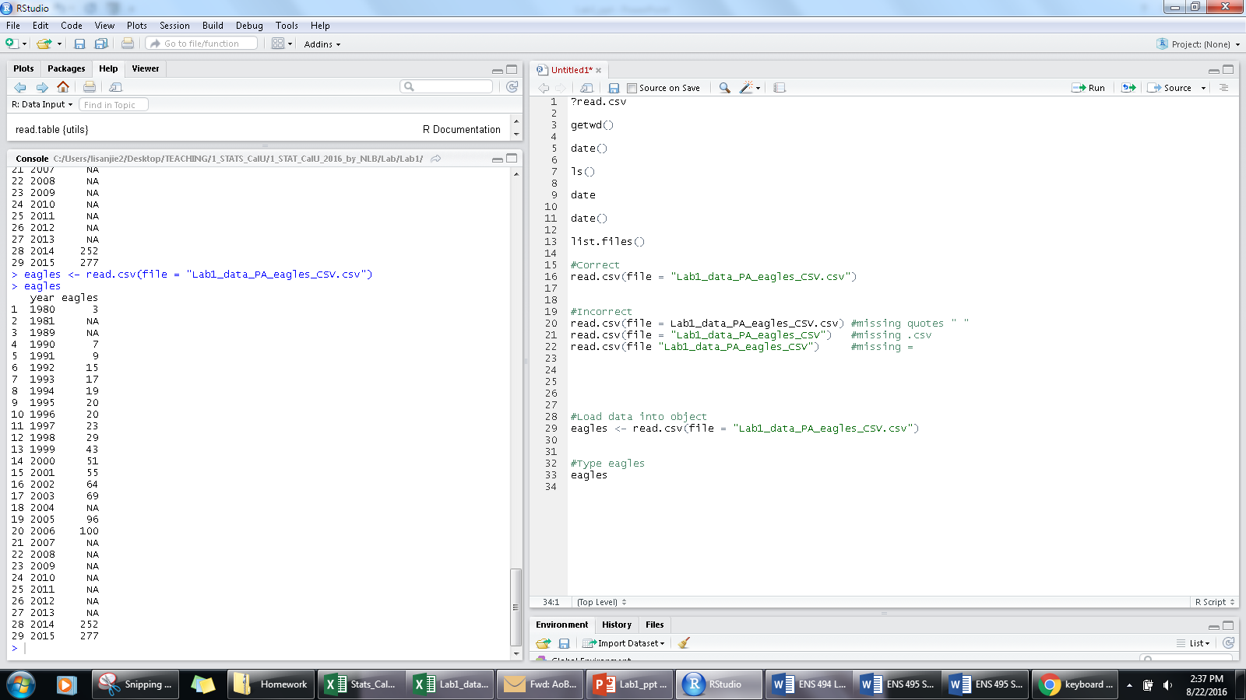
If you type just “eagles” and
execute it as a command what
Happens?

Slide 50

Execute the list command
ls() again In the console
you see
“eagles”.
This means that the
Object you assigned your data
is now in your “workspace.”

Slide 51
Interacting with data “objects” in R

Slide 52
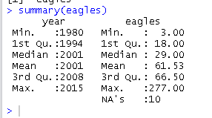
Execute the command “summary(eagles)”
DO NOT put the “>” in front of it

Slide 53
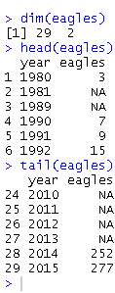
Execute these commands
dim(eagles),
head(eagls)
tail(eagles)
Try executing them directly from the console & also from the source viewer using “Cntl+Enter”

Slide 54
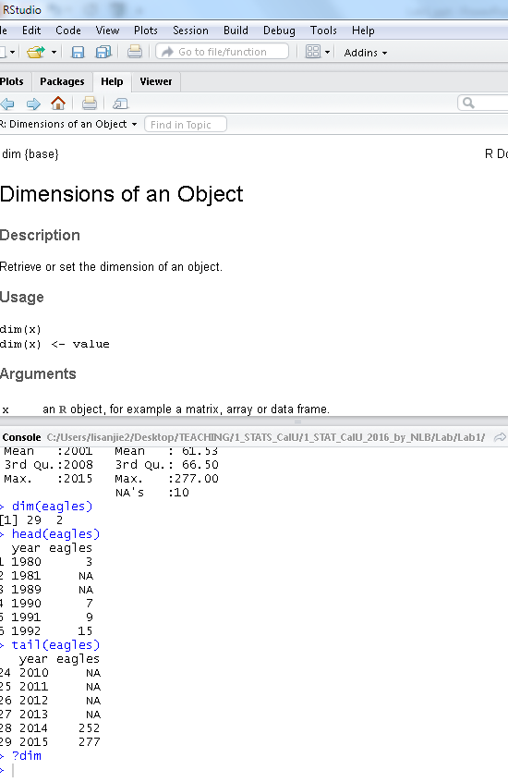
Call up help for dim() by typing
“?dim”
Unfortunately, the help files for R
Are designed w/programmers in
Mind and are typically very
Encyclopedic. You can usually get
Some useful information from
Them but often it can be hard
When you are a beginner to find
What you need

Slide 55
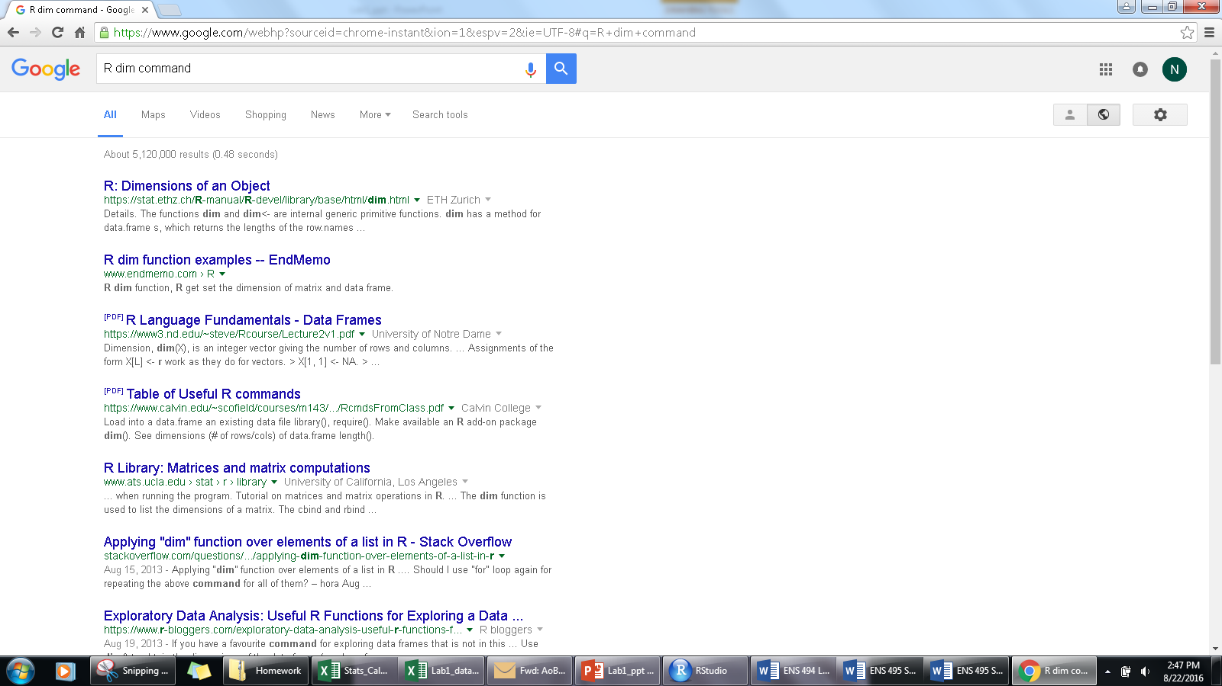
You can often find information
Online, eg, by googling
“R dim command”
Usually the R help file will come up
Other information will also show up

Slide 56

Interacting w/ data in R: plotting the number of eagles in PA

Slide 57

If you want to make a plot of the number of eagles over time in PA, what command do you think will do it?
Many R commands use fairly
Simple language…

Slide 58
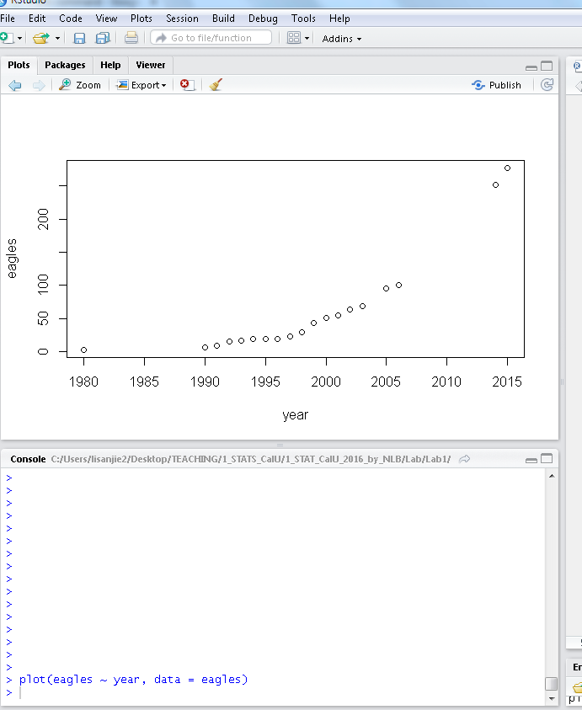
Execute the command
plot(count~year, data = eagles)
~

Slide 59
Execute the command
plot(count~year, data = eagles)
command
data
What we want on the x axis
(horizontal)
What we want on the y axis
(vertical)

Slide 60
Execute the command
plot(count~year, data = eagles)
~
This gets used a lot
Is kinda like “ = “

Slide 61
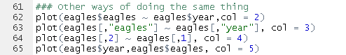
One thing that makes R tricky is that there are multiple ways to accomplish the exact same thing.
Try typing in these different commands.
The following commands all produce the exact same figure, just with different colors (via “col = …”).
One consequence of this fact is that different books/instructors/etc. will use slightly different approaches, making it sometimes tricky to compare code written by different people.

Slide 62
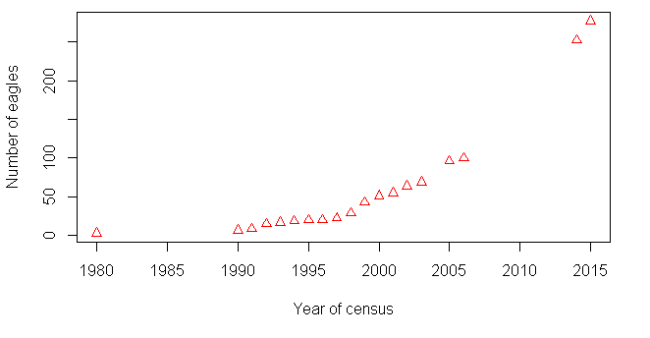
Customizing Plots in R

Slide 63
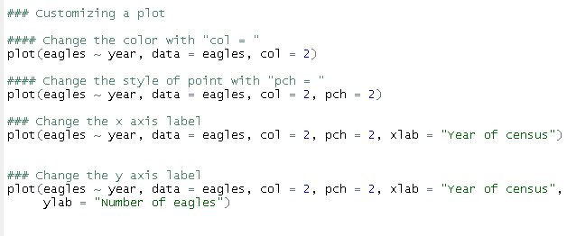
R plots can be customized almost infinitely. Type these different commands into the source viewer & execute them
NB: in the source viewer note that commands can occur on separate lines.

Slide 65
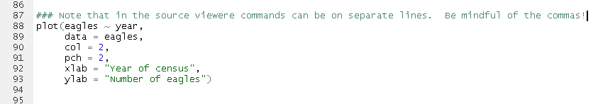
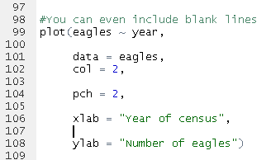

Slide 66
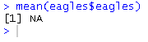
Summary Statistics in R
Try the following command
mean(eagles$eagles)

Slide 67
Summary Statistics in R
Now Try
mean(eagles$eagles)
mean(eagles$eagles, , na.rm = T)

Slide 68
Summary Statistics in R
Now Try
mean(eagles$eagles)
mean(eagles$eagles, , na.rm = T)
Mean(eagles$eagles, , na.rm = T)
“M” not m

Slide 69
Summary Statistics in R
Now Try
mean(eagles$eagles)
mean(eagles$eagles, , na.rm = T)
Mean(eagles$eagles, , na.rm = T)
“M” bad
m good

Slide 70
Summary Statistics in R
Now Try the following commands
mean(eagles$eagles, , na.rm = T)
median
min
max
summary
sd

Slide 72
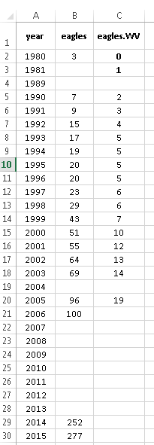
Adding new data to an R data file

Slide 73
Open up Excel file
Type in new data from your assigned state in a new
Column
Name the column “eagles.XX” where “xx” is the
Postal code for that state.
Be sure to separate the words with a period
R is unfortunately picky about what characters show
Up in its columns

Slide 74
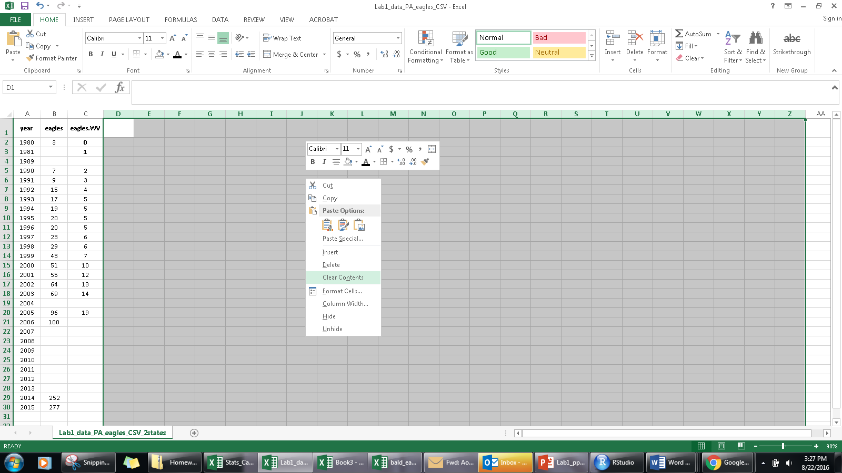
Preparing a file for loading into R
Things work best when you Excel file is “clean” & only has exactly what you want in it.
Any extra, accidental typing can cause problems or make things confusing.
A good practice is to always highlight cells to the right of and below your data, right click & select “Delete”. T
his will remove any accidental typing that occurred.
Do this below your data also.

Slide 75
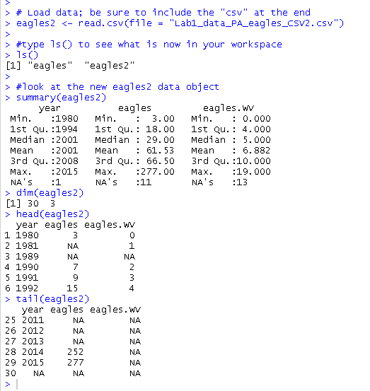
Reload the new data by changing the command in read.csv.
Name the new object “eagles”
eagles <- read.csv(file = "Lab1_data_PA_eagles.csv")
Examine the new data with these commands
dim()
head()
tail()
summary()

Slide 76

Reload the new data by changing the command in read.csv.
Name the object “eagles” as before
Plot the PA data and the data from the new state
plot(eagles ~ year, data = eagles, col = 1)
points(eagles.WV ~ year , data = eagles, col = 2)
New object name
Your state name

Slide 78

Exporting graphs from RStudio

Slide 79

Click on “EXPORT”

Slide 80

Click on “EXPORT”
Select “Copy to clipboard”

Slide 81

A window will pop up
Adjust the size and dimensions
By clicking and dragging the bottom Right corner

Slide 82

Click on “copy plot”
The window will disappear
The Plot is now stored in memory and can be pasted into PowerPoint or a Word docutment

Slide 83

In Word, it works well to right click in a document and click on the clipboard icon
The short cut “Crtl+V” should work in Word and PowerPoint

Slide 84


Slide 86

Adding data “by hand”

Slide 87


Slide 89

2007 Data
http://www.biologicaldiversity.org/species/birds/bald_eagle/report/

